Slide 1
CSE332 INDUSTRY ETHICS AND LEGAL ISSUES

Slide 2
- Creating an ethical work environment - Ethical decision making

Slide 3
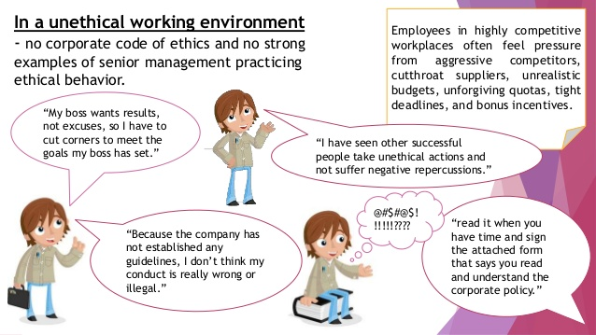
Creating an Ethical Work Environment

Slide 4
Creating an Ethical Work Environment
Employees must have a knowledgeable resource with whom they can discuss perceived unethical practices

Slide 5
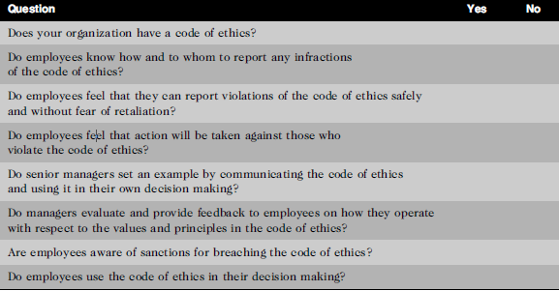
Creating an Ethical Work Environment
Manager’s checklist for establishing an ethical work environment

Slide 6

DECISION

Slide 7
1. Career Choice Scenario
You have two job offers:
Job A: Higher salary but located far from your family.
Job B: Lower salary but close to home with better work-life balance.
Decision: Which job should you choose and why?
2.Business Decision Scenario
You own a small café and notice that sales are decreasing.
Options:
Introduce new menu items.
Reduce prices.
Spend money on advertising.
Decision: Which strategy would you try first?

Slide 8
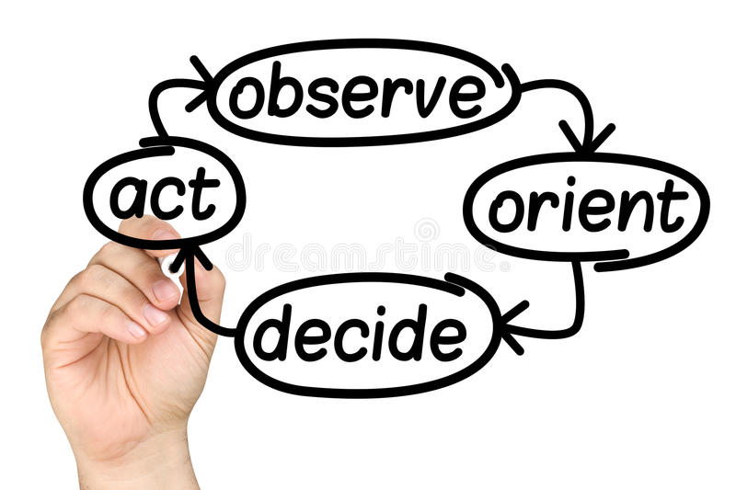
DECISION MAKING

Slide 9
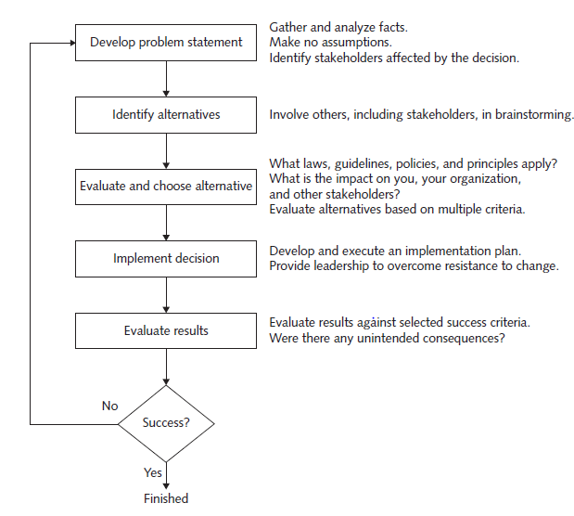
INCLUDING ETHICAL CONSIDERATIONS IN DECISION MAKING

Slide 10
DEVELOP A PROBLEM STATEMENT
A problem statement is a clear, concise description of the issue that needs to be addressed.
It Answers-
What do people observe that causes them to think there is a problem?
Who is directly affected by the problem?
Is anyone else affected?
How often does the problem occur?
What is the impact of the problem?
How serious is the problem?

Slide 11
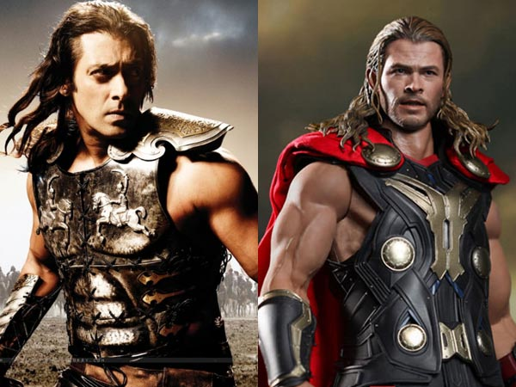

Poor problem statement
Good problem statement

Slide 12
IDENTIFY ALTERNATIVES
It is ideal to enlist the help of others, including stakeholders, to identify several alternative solutions to the problem.
Brainstorming with others will increase your chances of identifying a broad range of alternatives and determining the best solution.
Try not to be critical of ideas, as any negative criticism will tend to shut down the discussion, and the flow of ideas will dry up.
Simply write down the ideas as they are suggested.

Slide 13
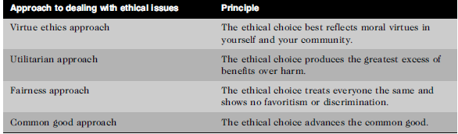
EVALUATE AND CHOOSE AN ALTERNATIVE

Slide 14
IMPLEMENT THE DECISION
Once an alternative is selected, it should be implemented in an efficient, effective, and timely manner.
Why are we doing this?
What is wrong with the current way we do things?
What are the benefits of the new way for you?

Slide 15
EVALUATE THE RESULTS
Were the success criteria fully met?
Were there any unintended consequences?

Slide 16
Next Topics:
Ethics in Information Technology
Ethical behavior of IT professional
Common ethical issues for IT users
Supporting the ethical practices of IT users

